Slide 1

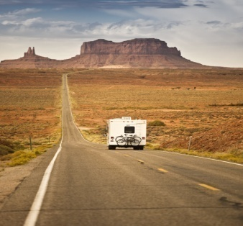
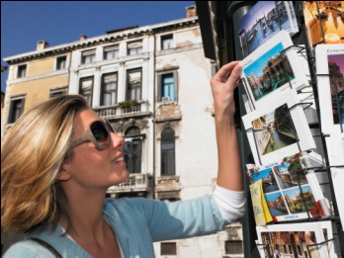
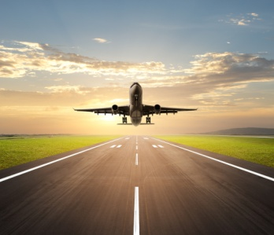
3
Unit 4 Section A
The Surprising purpose of travel

Slide 2
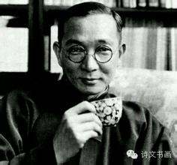
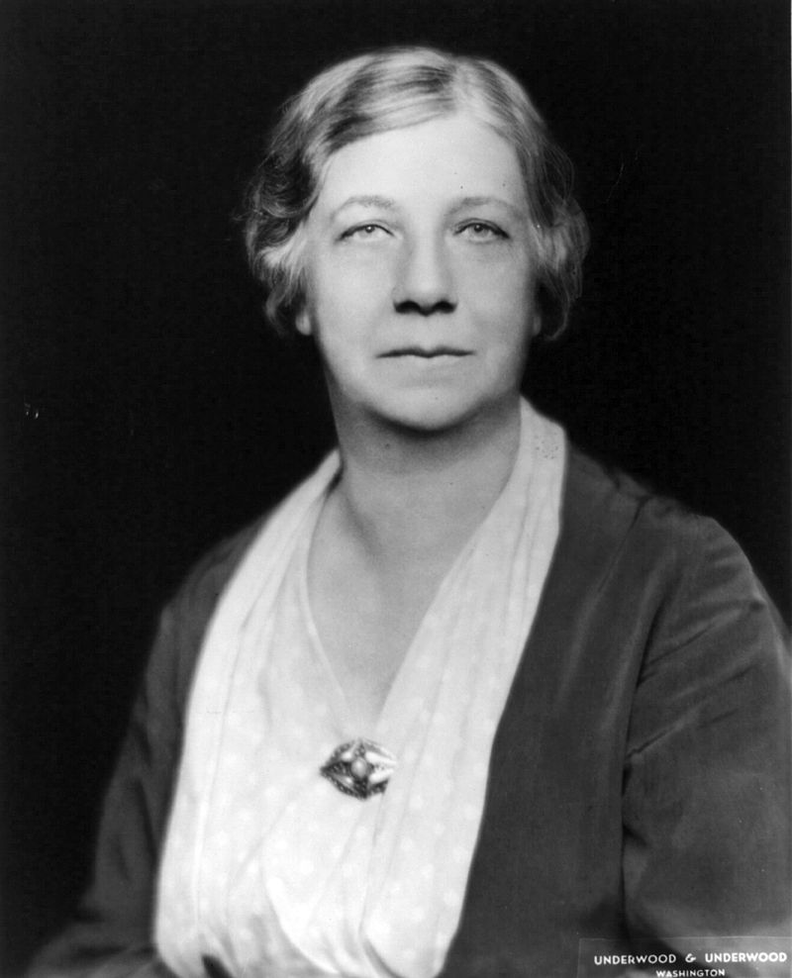
3
4
Let’s go
UNIT
No one realizes how beautiful it is to travel until he comes home and rests his headon his old, familiar pillow.
—Lin Yutang (Chinese writer)
Certainly, travel is more than the seeing of sights; it is a change that goes on, deep and permanent, in the ideas of living.
—Miriam Beard (American historian)

Slide 3

^{Section A}
3
4
Let’s go
UNIT
The Surprising purpose of travel
To talk about the surprising purpose of travel
Objectives
To understand the text fully
To apply the phrases and patterns
To master the cause-effect essay writing skill

Slide 4
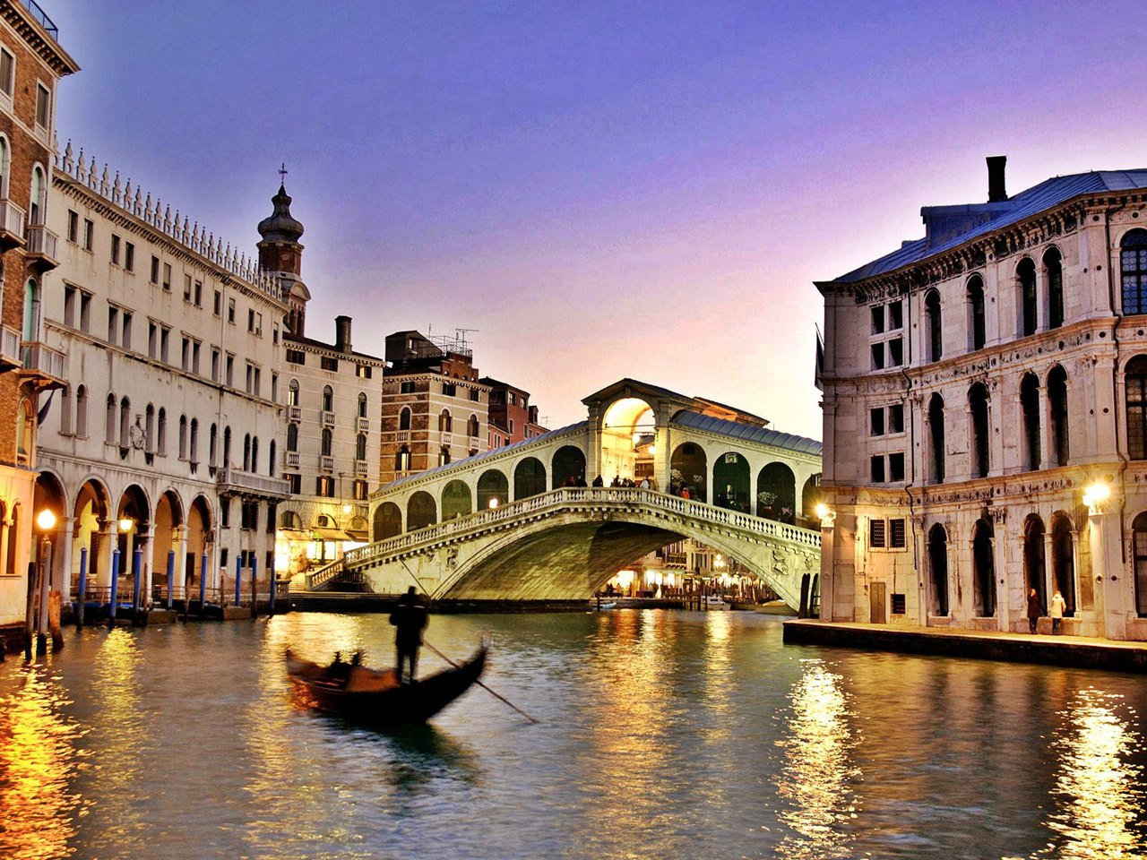




A
Section
The surprising purpose of travel
Contents
Warming-up Activities
Text Study
Language Application
Summary

Slide 5



A
Section
The surprising purpose of travel
Warming-up Activities
Lead-in
Pre-reading Activities
Cultural Background

Slide 6
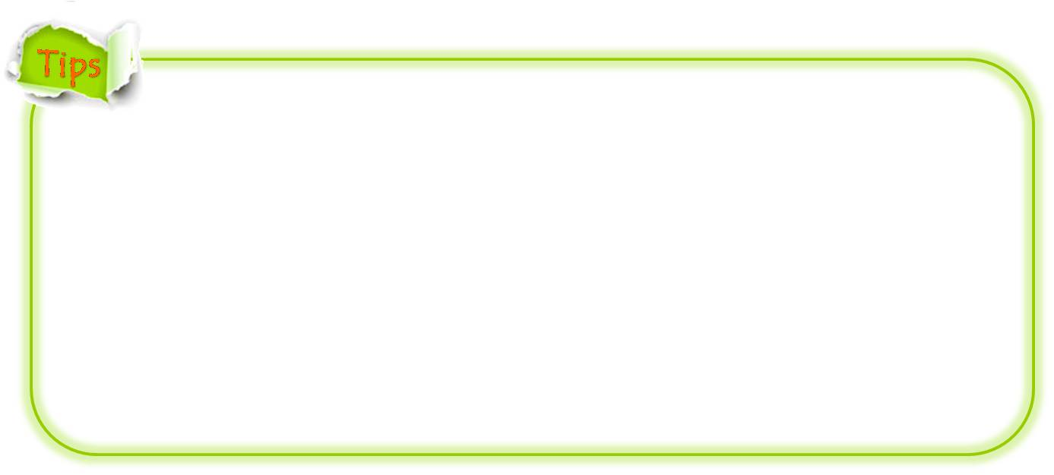
Lead-in
Group discussion
1. Write as many words related to travel as you can.
Varieties of travel
Means of transportation
Tourist attractions
Entertainment activities
Things to take
Where to stay
Other words about travel

Slide 7
Lead-in
Group discussion
2. Try your best to list the reasons that people travel.
To have a change
To experience something new and unfamiliar
To see the world and understand different culture
To marvel at the wonder of great nature
To escape from a boring lifestyle
To have a thorough relaxation
To broaden one’s horizons
……

Slide 8
Lead-in
Group discussion
3. Your suggestions to a student who wants to have a trip but doesn’t have enough money for it.
Plan ahead
Find useful information
Travel in group
Go to a less-known place
Pack necessary things

Slide 9
Lead-in
A Letter
Why We Travel
-a letter from Kent Nerburn to his son
We need to travel, if we don’t offer ourselves to the unknown, our senses dull, our world becomes small and we lose our sense of wonder. Our eyes don’t lift the horizon, our ears don’t hear the sound around us, our experience is restricted as we pass our days in a routine that is both comforting and limiting. We wake one day and we find that we have lost our dreams in order to protect our days.

Slide 10
Don’t let yourself become one of those people. The fear of the unknown and the lure of the comfortable will conspire to keep you from taking the chances a traveler has to take. But if you take them you will never regret your choice. Sure, there will be a moment of doubt when you stand alone, on an empty road, in an icy rain or when you are ill in a rented bed. In the end you will be a so much happier person, that’s all the risks and hardships will seem like nothing compared to the knowledge you have gained and the life you have lived.
Happy travels.

Slide 11
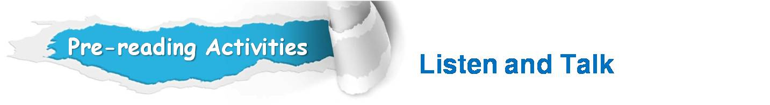


Listen to a talk about Xi’an and discuss the questions.
1. Why do many people choose to visit Xi’an?
2. Which place are you most interested in when you
are visiting Xi’an? Explain your reasons.

Slide 12

Why do many people choose to visit Xi’an?
One of the most ancient cities in China;
Its diverse and rich selection of local food;
Easily accessible and frequent flights and trains;
A reputation all over the world;
If you have not been to Xi’an, you have not been to China.

Slide 13
2. Which place are you most interested in when you are
visiting Xi’an? Explain your reasons.
I am most interested in visiting the Terracotta Army in Xi’an:
An admirable miracle of the world;
The exquisite high technology in Qin Dynasty;
A symbol of the long history and brilliant culture of China.

Slide 14
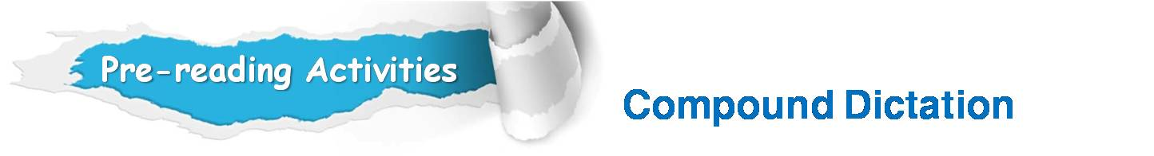

Listen to a short passage concerning aircraft accidents and fill in the missing information.
A plane disaster Sunday has increased fears among already worried travelers, especially those in Southeast Asia.
AirAsia flight QZ8501 ___________ from radar Sunday while flying from Surabaya, Indonesia to Singapore. The plane was carrying 155 passengers and seven ______________. All but seven were Indonesian. Three South Koreans were also on the plane along
disappeared
crewmembers
To be continued

Slide 15
Listen to a short passage concerning aircraft accidents and fill in the missing information.
with a passenger each from Britain, France, Malaysia and Singapore. AirAsia is a ________ airline with links to AirAsia Malaysia. Malaysian ________________has had a difficult 2014.
In March, the national ________, Malaysia Airlines, had a plane disappear over the Indian Ocean. That plane was carrying 239 passengers and crew from Kuala Lumpur to Beijing, China. _____________ have found no sign of the plane or the people it carried. The plane's disappearance _________ the world.
budget
air transportation
carrier
Investigators
shocked
To be continued

Slide 16
Listen to a short passage concerning aircraft accidents and fill in the missing information.
Several months later, Malaysia Airlines _________ another disaster. Flight 17 went down in Ukraine on July 17 after an apparent _________ strike. It was traveling from Amsterdam, Holland to Kuala Lumpur, Malaysia at the time. All 298 people on the plane were killed in the _______. Many travelers feared flying Malaysian airlines after flights 370 and 17. Now, many travelers are concerned about Air Asia.
suffered
missile
crash

Slide 17
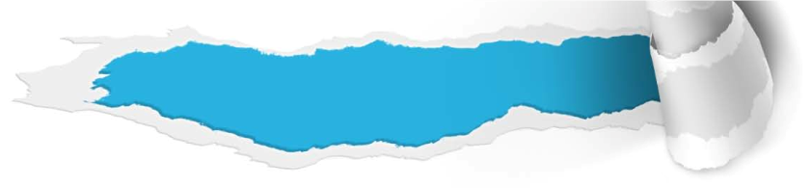

Cultural Background
Some Proper Names
Questions Previewing
1. Where is Left Bank café? What features does it have?
Tips
2. What is Let’s Go? Give more information about it.
Tips
3.What do you know about Machu Picchu?
Tips

Slide 18
Cultural Background
Some Proper Names
Where is Left Bank café ? What features does it have?
The Left Bank café﻿ is located in the village of Saranac Lake on the Left Bank of the River Seine in Paris. It is a favorite meeting place of great artists, writers, and famous intellectuals since the early 20th century. LBC serves authentic French café﻿-style food, including crê﻿pes and tartines, as well as coffee, tea, wines and beers.﻿﻿

Slide 19
Cultural Background
Some Proper Names
2. What is Let’s Go? Give more information about it.
A world-renowned travel guide series,
researched, written, edited, and run entirely
by students at Harvard University.
It is claimed to be “the student travel guide”
aimed at readers “both young and young at
heart”.
Let’s Go was founded in 1960 and is
headquartered in Cambridge, Massachusetts,
the US. office.

Slide 20
Cultural Background
Some Proper Names
3. What do you know about Machu Picchu?
An ancient ruined South American city high up
in the Andes mountains in Peru.
It was built by the Incas, a Native American
people of South America, in about 1500 AD,
It has a temple of the sun and many other
buildings.
It is a popular place for tourists to visit.

Slide 21

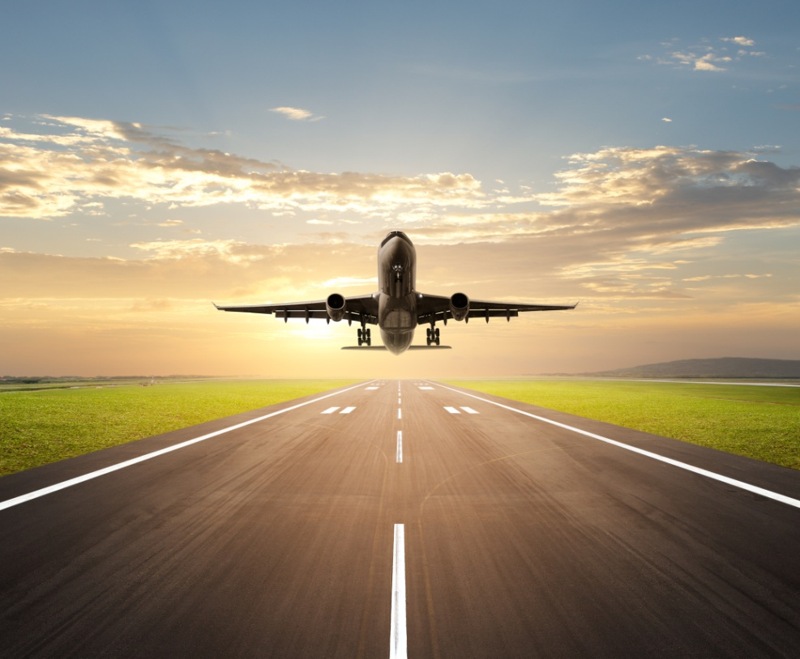
A
Section
The surprising purpose of travel
Text Study
Main Idea & Structure
Language Focus
Critical Thinking

Slide 22

The text is _______________ that tries to illustrate _____________ why we travel — because we need ________________ for creativity.
an exposition
the reasons
mental refreshment
imaginary scene
The author describes the _________________ of a typical _________________ trip. (Para. 1)
burdensome

Slide 23

Why does the author choose the word “burdensome” to describe his imaginary travel? (Para. 1)
Tips
It’s 4:15 in the morning, and … stolen away a lovely
dream;
The taxi is late and then lost;
I am getting increasing nervous that …
Run in , stagger through … and finally get to …
My flight is cancelled and …

Slide 24
According to the author, what does traveling mean? (Para. 1)
Tips
Traveling is a burdensome series of running and waiting, and after countless hours, finally getting there.

Slide 25
What does the author mean by “the rest of the journey can feel like a tedious lesson in the ills of modernity. It sucks.” ? (Para. 2)
Tips
The author means that the rest of journey is
actually very boring. They have to endure and tolerate the terrible experience in the modern world which brings people convenience as well as tediousness as a result of globalization.
Journey is not enjoyable any more.

Slide 26

Suppose travel is troublesome and sometimes even unpleasant, why do we travel according to the author? (Para. 2-4)
Tips
● We travel because we need to. Sometimes our travel is a must because we should attend the business luncheon, because we should celebrate Thanksgiving with mom and because we should see our girlfriend in the 2-year anniversary.
● We travel because we want to. Owing to the fact that most travel is optional, we just travel following our heart.

Slide 27

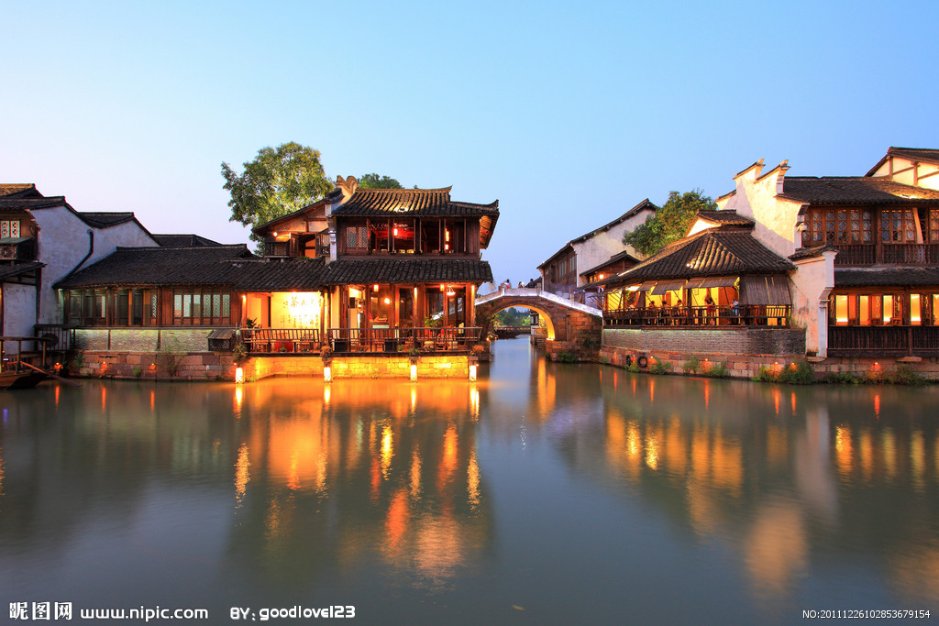
What kind of travel is truly compulsory? (Para. 4)
Tips
Only corporate travel, about 30% of trips over
50 miles, is truly compulsory.

Slide 28

Part I — (Paras. 1- __)
4
The author gives us a vivid description of the imaginary travel experience, including how he struggles to get up in the early morning, how he gets to the flight gate________________ and how he finally __________ in the airport.
after all trouble
gets stuck
To be continued

Slide 29

What are the benefits of modern aviation? (Para. 5)
Tips
Thanks to modern aviation, we can now move through space at an inhuman speed. We can outrun the sun and move from one hemisphere to another in a single day.

Slide 30

What is the irony when people travel to Paris trying to leave all those troubles behind? (Para. 5)
Tips
Their mind is most likely to solve their most stubborn problems while they are sitting in luxury in a Left Bank café.

Slide 31
How does a bit of distance help enhance creativity according to Paragraph 6? (Para. 6)
Tips
A bit of distance helps loosen the cognitive chains that imprison us, making it easier to mingle the new with the old; the mundane is grasped from a slightly more abstract Perspective. (or: Traveling to a new place can make us less controlled by familiar cognitive patterns we used to have. As a result, we can better combine the new with the old in our thinking.)

Slide 32

What is the finding of the research? What does the author wants to prove by referring to the example? (Para. 6)
Tips
According to the research, the experience of an exotic culture endows us with a valuable open-mindedness, making it easier to realize that even a trivial thing can have multiple meanings. The author wants to make the realization mentioned in the research clearer and easier to understand.

Slide 33
Seasoned travelers
multicultural contrasts (Para. 7)
open to ambiguity interpret the world
in different ways
Means?
to expand the circumference of their
“cognitive inputs”
Possible effects?

Slide 34

What do we need to do to trigger our creativity? (Para. 8)
Tips
We need to try the difference by changing cultures and experiencing the disorienting diversity of human traditions.

Slide 35
pleasant
Para. 8
Instead, this renaissance of creativity appears to be a ________________________: We need to change cultures, to experience the disorienting diversity of human traditions. The same facets of foreign travel that are so confusing turn out to ____________________, making us more creative because we’re less insular.
side effect of difference
have a lasting impact
To be continued

Slide 36
pleasant
Para. 8
We’re reminded of all that we don’t know, which is nearly everything; we’re surprised by the ___________________________. Even in this globalized age, we can still be amazed
at __________________that weren’t included in the Let’s Go guidebook and that certainly don’t exist back home.
constant stream of surprises
all the earthly things

Slide 37

What are the drawbacks of travel? (Para. 9)
Tips
To endure jet lag;
To be lost in somewhere while travelling;
To lose luggage.

Slide 38


What are the secret cornerstones of creativity of travel? (Para. 9)
Tips
Distance and differences.
What will happen to us after travel? (Para. 9)
Tips
Travel will change our mind to some extent,
which in turn can have effects on everything in our life.

Slide 39
Part III — (Para. 9)
The author warns us against pretending travel has no ___________ and that we take great delight in the unpleasantness. The last sentence echoes the view that distance and difference are the _________________ of creativity.
drawbacks
secret cornerstones

Slide 40

The introduction
It gives us a vivid description of the author’s imaginary travel experience, including how he struggles to get up in the early morning, how he gets to the flight gate in the airport. (Para. 1)
The author puts forward a question and gives two traditional answers to it. We travel because we need to. We travel because we want to. (Para. 2-4)

Slide 41
The introduction
The body
The author takes
us to rethink the
question: What is
the real purpose of travel? (Para. 5)
The author’s own understanding of
the real purpose of travel.
Explanation from the perspective of science (Para. 6)
Take experienced travelers as an example (Para. 7)
Where this mental flexibility comes from (Para. 8)

Slide 42
The introduction
The body
The conclusion
We travel because we need to , because distance and difference are the secret cornerstones of creativity. (Para. 9)

Slide 43
The introduction
The body
The conclusion

Slide 44

The Surprising Purpose of Travel
Travel is ___________ and sometimes even unpleasant; then what is the driving force behind our travel? We travel because we need to. Sometimes our travel is a ____ because we should attend the business luncheon, because we should celebrate Thanksgiving with our mom. We travel because we want to.
burdensome
must
To be continued

Slide 45
optional
Owing to the fact that most travel is _______, we just travel following our heart. Most people travel for the sake of __________, but their mind tends to solve the stubborn ___________ issues while on vacation. What is the real purpose of travel? Travelling to a new place can make us less controlled by familiar cognitive ________ that imprison us. As a result, we can better combine the new with the old, the mundane is ________ from a slightly more abstract perspective.
relaxation
domestic
patterns
grasped
To be continued

Slide 46
To __________ travelers, multicultural contrast means that they are open to ambiguity and willing to see the world in different ways, thus to expand the ______________ of their “cognitive inputs” as they refuse to __________ their first answers and initial guesses. Of course, that mental flexibility is a side effect of difference and we know what we did not know in the past, by which we become more open-minded and less _______.
seasoned
circumferences
settle for
insular
To be continued

Slide 47
Apart from its advantages, travel also has it _________, which make us not take great pleasantness. More often than not, we need a _________ after our vacation. We travel because we need to , because distance and difference are the _____________ of creativity. Travel will change our mind to some extent, which in turn can have ________ on everything in our life.
drawbacks
vacation
cornerstones
effects

Slide 48
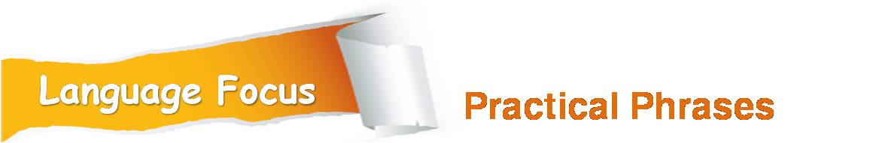
Practical Phrases | Specific Meanings
1. be offset by sth. | 由……抵消
2. on sale | 廉价出售
3. mingle… with … | 与……混在一起
4. endow …with… | 赋予……(天资)
5. be open to sth. | 愿意考虑……
6. more often than not | 往往， 多半
7. be saturated with | 充满；使饱享

Slide 49

由……抵消
短语逆译
be offset by sth.
短语应用
他们增加的工资会被上涨的物价所抵消。
意群提示
(salary increase /rising prices )
Their salary increase will be offset by rising prices.

Slide 50
廉价出售
on sale
短语逆译
短语应用
通过阅读这份广告，你也许会发现想要的某件商品正在减价。
意群提示
(advertisement / on sale)
By reading the advertisement, you may find something you want on sale.

Slide 51
与……混在一起
短语逆译
to mingle… with…
短语应用
校长发表了一个褒贬兼蓄的演讲。
意群提示
( to deliver a speech/praise/blame)
The president delivered a speech that contained praise mingled with blame.

Slide 52
赋予… (天资)
短语逆译
to endow … with …
短语应用
将军忠实的拥护者们几乎把他当神一样看待。
意群提示
( devoted supporter /godlike status)
The general’s devoted supporters endow him with an almost godlike status.

Slide 53
愿意考虑…
短语逆译
be open to sth.
短语应用
我肯定他们会愿意倾听大家任何意见和建议。
意群提示
(be sure/ any comments and suggestions from…)
I’m sure they will be open to any comments and suggestions from everyone.

Slide 54
往往， 多半
短语逆译
more often than not
短语应用
人们觉得不幸福多半是因为他们太容易受到外界的影响了。
意群提示
( be easily affected/ the outside world)
More often than not, people are not happy because they are too easily affected by the outside world.

Slide 55
充满；使饱享
短语逆译
be saturated with
短语应用
他们从媒体得到了大量煽情诱人的消息。
意群提示
(powerful and seductive messages/the media)
They've become thoroughly saturated with powerful and seductive messages from the media.

Slide 56

Functional Patterns | Functions & Usages
1. Sb. almost do…before…and sb. do…, remembering that… | 用于表达“某人受到暗示或提示后采取的行动”。
2. Sb. do sth. because sb. like / dislike to, because…. | 用于表达“某人喜欢/不喜欢做某事的种种原因”。
3. According to research, sth./sb. do…, making /leading … | 用于引证，表达“研究发现/结果表明”。

Slide 57
原句译文
要不是突然看见早已收拾好的行李箱，我几乎又要睡着。想起来还要去机场，我叹了口气。
逆译练习
I almost return back to sleep before my eye catches my packed suitcase and I groan, remembering that I’m going to the airport. (Para. 1)
句型提炼

Slide 58

句型提炼
Sb. do sth. before …and sb. do sth, remembering that….
应用提示
用于表达“某人受到暗示或提示后采取的行动”。
句型应用

Slide 59
典型例句
要不是我突然瞥见妈妈期待的神情，我几乎都要放弃该场比赛了。想起来还有几个比赛，我又一次站了起来。
意群提示
(expecting looks /compete in )
I almost gave up the game before my eyes caught my mom’s expecting looks she wore on the face and I stood up again, remembering that I still had more games to compete in.

Slide 60
原句译文
我们旅行是因为我们想要去旅行，因为到一个新地方的兴奋和激动可以抵消在机场的各种烦心事。
逆译练习
We travel because we want to, because the annoyances of the airport are offset by the thrill of being someplace new. (Para. 4)
句型提炼

Slide 61
句型提炼
Sb. do sth. because sb.like/dislike to, because….
应用提示
用于表达“某人喜欢/不喜欢做某事的种种原因或理由”。
句型应用

Slide 62
典型例句
我网购是因为我喜欢网购，因为网购可以免去我的腿脚之苦从而节省精力。
(online shopping / save feet)
I shop online because I like to, because online shopping can save my feet and energy.

Slide 63
原句译文
有研究指出，体验异国文化可以赋予我们宝贵的开放性思维，使我们更容易明白即使是微不足道的事物也可以有多种意义。
逆译练习
According to research, the experience of an exotic culture endows us with a valuable open-mindedness, making it easier to realize that even a trivial thing can have multiple meanings. (Para. 6)
句型提炼

Slide 64
句型提炼
According to research, sth. / sb. do …, making it easier to do …
应用提示
用于引证，表达“研究发现/结果表明”。
句型应用

Slide 65
典型例句
根据最近的调查，汽车拥有量已经在过去的五年时间里翻了一倍，致使交通事故不断攀升。
意群提示
(recent survey / doubled / climbing )
According to a recent survey, the number of car doubled over the past five years, leading to the climbing traffic accidents.

Slide 66



我们要想认识到旅
行在提高创新力方面的价值，还得再全面考虑其目的。
a. If we want to realize the creative benefits of travel, then we have to rethinks its overall purpose. (Para. 5, L4)

Slide 67
b. A bit of distance, however, helps loosen the cognitive chains that imprison us, making it easier to mingle the new with the old; the mundane is grasped from a lightly more abstract perspective. (Para. 6, L4)
然而，一点的距离就可以帮助我们放松禁锢我们认知的链条，使新旧思想的结合更容易，使平淡无奇的事情可从更抽象的角度加以认知。

Slide 68
c. Of course, this mental flexibility doesn’t come from mere distance, a simple change in latitude and longitude. Instead, this renaissance of creativity appears to be a side effect of difference. (Para. 8, L6)
当然，这种思维的灵活性不仅仅来自纯粹的距离变化，即简单的经纬度的变化。相反，这种创造力的复兴似乎是差异所带来的副产品。

Slide 69
d. We travel because we need to, because distance and difference are the secret cornerstones of creativity. (Para. 9, L4)
我们旅行是因为我们需要旅行，因为距离与差异是创造力的秘密基石。

Slide 70
我们回家后，家还是那个家，但是我们的思维已经有所改变，而这就可以改变一切。 。
e. When we get home, home is still the same. But something in our mind has been changed, and that changes everything. (Para. 9, L6)

Slide 71


What is the most useful purpose of travel in your opinion?
Tips
Do you agree that cultural difference is the biggest barrier in travel?
Tips
Can travel affect our personalities? If so, how?
Tips

Slide 72

What is the most useful purpose of travel in your opinion?
• To see new places and meet new friends.
• To have a break from the routine life.
• For business.
• To visit friends and relatives.

Slide 73
2. Do you agree that cultural difference is the biggest
barrier in travel?
\\
Yes, I agree. Cultural difference poses a huge problem to travel. If we don’t know the language, the customs, and history of the place we are visiting, we will face many embarrassing problems in communicating with the local people and may even violate the taboos in another culture without being aware of it.
I’m afraid not. Cultural difference is not a problem at all. On the contrary, it can serve as a stimulus to enable us to be more curious about this world and gain a deeper understanding of other cultures as well as our own culture.

Slide 74
3. Can travel affect our personalities? If so, how?
I think travel can affect our personalities. In most situations, people’s personalities will be more or less changed when travel comes to an end, just as the green and luxuriant plants after a rain. We can see such differences from people’s lively appearance, relaxed spiritual state, cheerful ways of talking, walking, and even smiling.
To be continued

Slide 75
3. Can travel affect our personalities? If so, how?
No, I don’t think travel can have an effect on our personality. Personality is our whole character and nature and is greatly affected by the environment in which we live. Personality is relatively stable. Maybe during a travel, our personality may change a little since we are in a different environment, but this change is temporary and shouldn’t last long. When we come back, we are still in the old environment. Obviously, our personality will regain its old traits just in a couple of days or weeks.

Slide 76

How do you understand the following quotes “读万卷书不如行万里路。”and “Travel is fatal to prejudice….and narrow-mindedness … ”?
This old Chinese saying tells us that travelling is a good way to experience life.
Getting ahead in your career is not just about getting good grades or test scores in school. It is also about having real experience with the world beyond your borders — experience with languages, cultures and societies very different from your own.
To be continued

Slide 77
How do you understand the following quotes “读万卷书不如行万里路。” and “Travel is fatal to prejudice…and narrow-mindedness…”?
But Mark Twain, the famous American writer, believes that travel to foreign places, experiencing new foods, unusual sights, strange sounds and unfamiliar behaviors, not only provides great memories but amazingly, causes changes in our brains and our perceptions.

Slide 78




Watch a video clip and discuss some questions.
Q: How is the man in the song different from that in the past after he took a travel to the riverside?
Tips
Video Watching

Slide 79

How is the man in the song different from that in the past after he took a travel to the riverside?
In the past
He was doubling over the load on his shoulders;
He was crossing miles of frustrations and rivers;
He was picking up stones he found along the way;
He staggered and stumbled down pathways and
with each step taken his back was breaking.
to be continued

Slide 80
How is the man in the song different from that in the past after he took a travel to the riverside?
After the trip
He laid his burdens down.
His spirit lifted high, he found his freedom now.

Slide 81

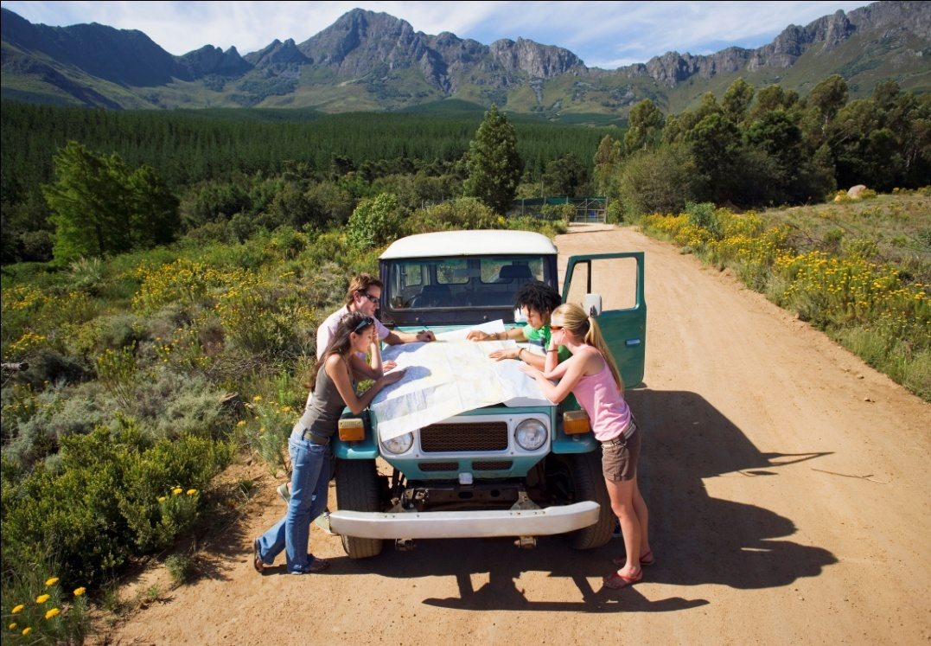
A
Section
The surprising purpose of travel
Language Application
Writing Devices
Oral Reproduction
Paragraph Translation

Slide 82

Develop a cause-and-effect essay
The purpose of cause-and-effect essays is to explain to the reader:
the causes of an event or situation;
(2) the effects of an event or situation; or
(3) both the causes and effects.
In this unit, we will focus on the causes of an event or situation.
The usual logical pattern we follow when writing such a kind of essay is like this:
to be continued

Slide 83
Cause 1
Effect
Cause 2
Cause 3
to be continued

Slide 84
Develop a cause-and-effect essay
An essay of causes begins with an introduction which briefly describes the effect, and then the entire body of the essay analyzes the causes.
When writing the essay, try to remember the following logical requirements:
to be continued

Slide 85
Develop a cause-and-effect essay
1. Do not oversimplify causes.
2. Beware especially of making a mistake in
logic known as the fallacy of post hoc,
ergo propter hoc –Latin words meaning
“after this, therefore because of this”. For
instance, if a disease broke out soon after
X became Minister of Public Health, we
would probably make a mistake in logic in
saying that the epidemic broke out because
X was made minister. Remember sequence
does not always indicate causation.
to be continued

Slide 86
Develop a cause-and-effect essay
3. Distinguish between direct and indirect
causes and between major and minor
causes.
4. Do not omit links in a chain of causes.
5. Be objective and support the analysis
with solid, factual evidence.
to be continued

Slide 87
Language tips
Try to avoid using because and as a result repeatedly in a cause-and-effect essay. Here are some other transitional words and phrases:
since, consequently, therefore, accordingly, because of, for that reason, thus, then, hence, due to, so …that, such … that, the more ... the more, result from, lead to, contribute to, cause, result in, be the reason
for, be the consequence of.
to be continued

Slide 88

Let’s look at Text A which is a typical essay of cause.

Slide 89
How the author struggles to get up in the early morning and gets to the flight gate after all the trouble; how he finally gets stuck in the airport.
An interesting opening (Para. 1 )
Thesis question (Para. 2 )
Why do we travel?
We need to. (Para. 3)
We want to. (Para. 4)
We can improve our
creativity. (Paras. 5-8)
Three causes (Paras. 3-8 )
Conclusion (Para. 9 )
Review the causes

Slide 90
Read the sample essay and see how the causes are developed.

Slide 91
Topic:
Why learn the Chinese language?
Introduction:
Thesis statement: In recent years more and
more foreigners are beginning to take an
interest in the Chinese language.
to be continued

Slide 92
Body:
Cause1: China’s ancient culture has attracted
many people in the world.
Cause2: China is enjoying rapid economic growth, and its economic and cultural exchange with other countries has increased continuously.
Cause3: The Chinese language itself has charm
in its characters and pronunciation.
to be continued

Slide 93
Conclusion:
The Chinese language is sure to spread more widely in the world.
to be continued

Slide 94
Sample:
In recent years more and more foreigners are beginning to take an interest in the Chinese language. According to a survey, Chinese language courses are given in more than 3,000 schools in over 109 foreign countries.
to be continued

Slide 95
Sample:
There are various factors for the widespread
interest in Chinese. One of the most common
causes is that China’s ancient culture has attracted many people in the world. More and more foreigners are becoming interested in this oriental country and enjoying its splendid culture. To understand and study this culture, one must
learn the Chinese language. Another contributing cause is that China is enjoying rapid economic growth, and its economic and cultural exchange with other countries has increased continuously.
to be continued

Slide 96
Sample:
Consequently, people who can speak Chinese will be popular in job market. Perhaps the primary factor is that the Chinese language itself has charm in its characters and pronunciation: The picturesque Chinese characters arouse in some foreigners a sense of beauty and are considered attractive. The pronunciation of Mandarin Chinese (Putonghua) is so beautiful and musical that it has attracted many foreigners to learn.
to be continued

Slide 97
Sample:
Many people believe that the Chinese language will become a more important language in the world in decades to come. As China will open further to the outside world, its language is sure to spread more widely in the world.

Slide 98
Writing practice
Directions: Write an essay of no less than 200 words on one of the following topics. One topic has an outline you can follow.

Slide 99
Topic: Stressful life for kids
Introduction: Thesis statement: Some parents tend to expect too
much from their children.
Body:
Cause 1: The harsh reality
Cause 2: The peer pressure
Cause 3: Parents’ love for their kids
Conclusion: To set reasonable expectations for the kids is no easy, but is worth trying.

Slide 100
More topics:
• The grain crisis
• Why delay marriage?

Slide 101
Oral Reproduction
Group discussion
Explain your choice
on the following topic.
Suppose you are debating with
your classmates. You want to
show them why you choose to
shop online.

Slide 102

Oral Reproduction
Group discussion
You can follow the outline given below.
Part I. Introduction
1. Current situation about online shopping;
2. Thesis statement: Your feelings and
impressions about the online shopping.
To be continued

Slide 103
Oral Reproduction
Group discussion
You can follow the outline given below.
Part II. Body (various reasons provided )
Cause1. Convenience of online shopping.
Cause2. Goods online cheaper than in stores.
Cause3. Access to a wider range of options.
Cause4. Privacy protection.
Part III. Conclusion
The future of online shopping. ( sure to spread
more widely in the world. )

Slide 104
Oral Reproduction
Group discussion
You may adopt the following expressions.
on sale
more often than not
be open to sth.
expand the circumference of
experience the diversity of
have a lasting impact on
the constant stream of surprises
all the earthly things

Slide 105

Translate a paragraph based on a summary of the text by using the expressions from
the text.

Slide 106
旅游不但麻烦多多,有时甚至产生不快。那么，何为我们出去旅游的驱动力呢？到一个新的地方去旅游可以使我们放松禁锢我们认知的链条。对于经验丰富的旅行者来说，多元文化对比意味着他们会接受对事务的多样性解读，他们欣然认识到对这个世界可以有截然不同的方式进行解释，从而扩大了他们“认知输入”的范围。
driving force
cognitive chains
are open to
cognitive inputs
To be continued

Slide 107
当然，这种思维的灵活性是差异所带来的副产品，了解了过去不曾知道的事情，因此我们变得更为心胸开阔不再那么视野狭隘。我们旅行是因为我们需要旅行，因为距离与差异是创造力的秘密基石。旅游在某种程度上会改变我们的思维，进而影响到我们生活中的所有。
a side effect of
more open-minded and less insular
secret cornerstones of creativity
have an effect on
Samples

Slide 108
Travel is troublesome and sometimes even unpleasant; then what is the driving force behind our travel? Travelling to a new place can help us loosen cognitive chains that imprison us. To seasoned travelers, multicultural contrast means that they are open to ambiguity and willing to see the world in different ways, thus to expand the circumferences of their “cognitive inputs”. Of course, that mental flexibility is a side effect of difference and we know what we did not know in the past, by which we become more open-minded and less insular. We travel because we need to, because distance and difference are the secret cornerstones of creativity. Travel will change our mind to some extent, which in turn can have effects on everything in our life.

Slide 109

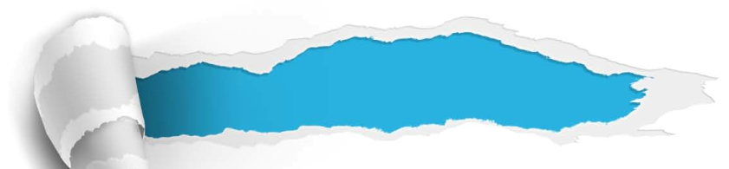

A
Section
The surprising purpose of travel
Summary
Revision of
the Useful Expressions
Thematic study
Revision of
the Functional Patterns

Slide 110
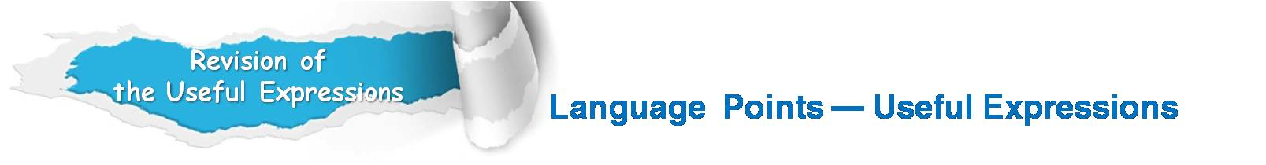
1. 从美梦中惊醒
2. 被困在了机场
3. 飞行的奇妙感觉
4. 现代弊病的课程
5. 以非人的速度在空中穿 梭
6. 意识到旅行在提高创新 方面的价值
7. 以字义明确的散文方式 思考
8. 放松认知的链条
9. 体验异国文化
steal away a lovely dream
be stuck in the airport
the wonder of being airborne
a lesson in the ills of modernity
move through space at an inhuman speed
realize the creative benefits of travel
think in finite, literal prose
loosen the cognitive chains
experience of an exotic culture

Slide 111
endow us with a valuable open-mindedness
10. 赋予我们宝贵的开放 性思维
11. 扩大认知输入范围
12. 满足于最初答案
13. 差异带来的副产品
14. 体验纷繁的多样性
15. 产生种持久的影响
16. 接连不断的惊喜
17. 所有平常的东西
18. 创造力的秘密基石
expand the circumference of one’s cognitive inputs
settle for their first answers
a side effect of difference
experience the disorienting diversity
have a lasting impact on
the constant stream of surprises
all the earthly things
secret cornerstones of creativity

Slide 112
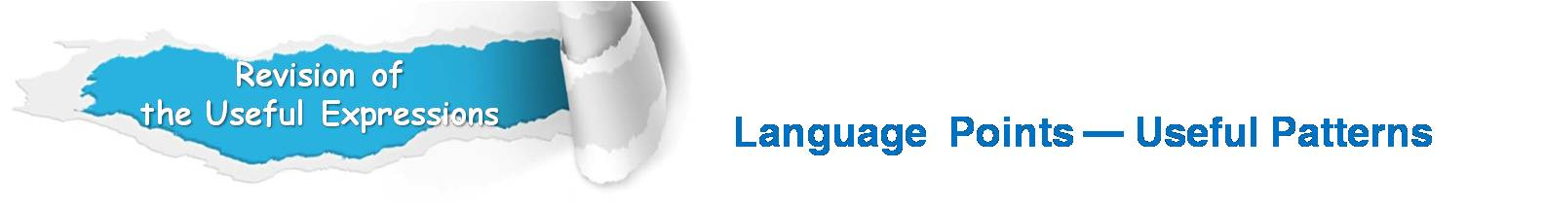
Functions & Usages | Sentence Patterns
1.用于表达“某人受到暗示 或提示后采取的行动”。
2.用于表达“某人喜欢/不喜 欢做某事的种种因”。
3.用于引证，表达“研究发 现或结果表明”。
Sb. almost do … before … and
sb. do …, remembering that …
Sb. do sth. because …
sb. like / dislike to, because …
According to research, sth. / sb. do …, making / …
Notes:
上面挤，下面空

Slide 113


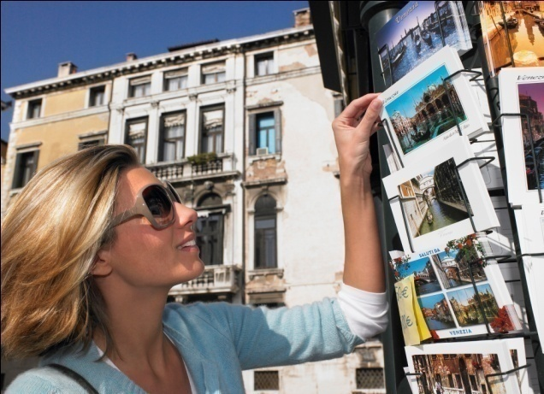
A
Section
The surprising purpose of travel
The end

